Slide 1

Grayscale Image Colorization
Illuminating Darkness

Slide 2

Team Members
Ahmed Hamdy
Ahmed Kamal
Ahmed Mostafa
Ahmed Nasser

Slide 3
Supervision
Dr. Dina Khattab
TA. Nora Youssef

Slide 4
Introduction
Colorization — adding colors to gray-scale images .
The underlying issue is that the resultant image needs to be perceptually meaningful, and visually appealing.

Slide 5
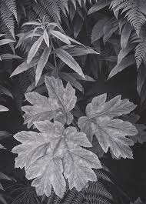
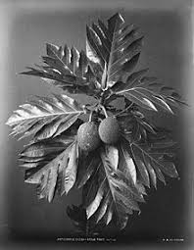
Problem Definition
Automated image colorization is an ill-posed problem, as two objects with different colors can appear the same on grayscale image .

Slide 6

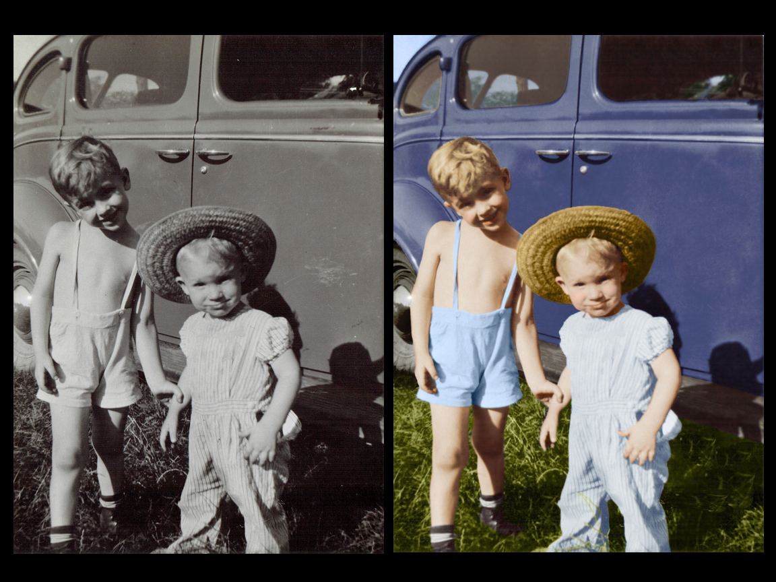
Problem in terms of input & output Input : Grayscale image.. Output : Colorized version of the grayscale image..

Slide 7
Current Status
Stages Finished.
Problems Faced.
Limitations.
Next Step.

Slide 8
Stages Finished
Building DataSet
Building and Training the model
Testing the model

Slide 9
Stages Finished
Building DataSet

Slide 10
Stages Finished
Building DataSet
MIT Places Scenes Dataset [Zhou+ 2014]
2.3 Million training images 256 x 256 RGB [24GB]
We Used 3000 samples from “Forest Road & Nature” category.

Slide 11
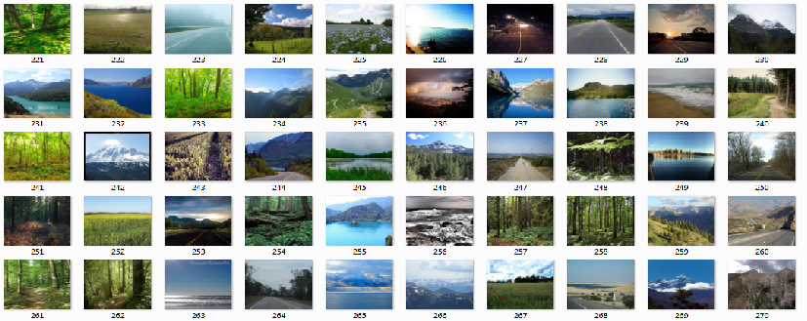
Stages Finished
Building Dataset

Slide 12
Stages Finished
Building DataSet
Building and Training the model

Slide 13
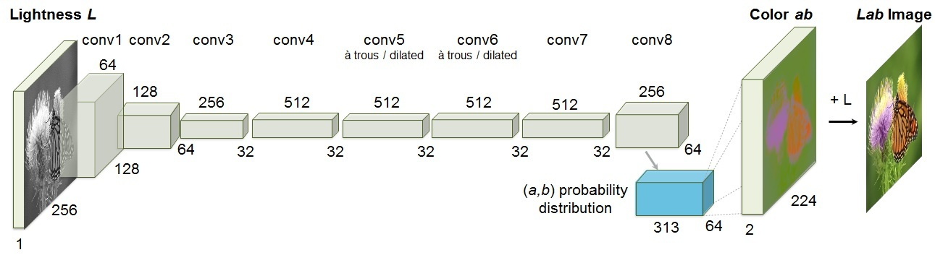
Stages Finished
Building and Model Training
We First made an implementation of the “Colorful Image Colorization In ECCV 2016” paper.

Slide 14
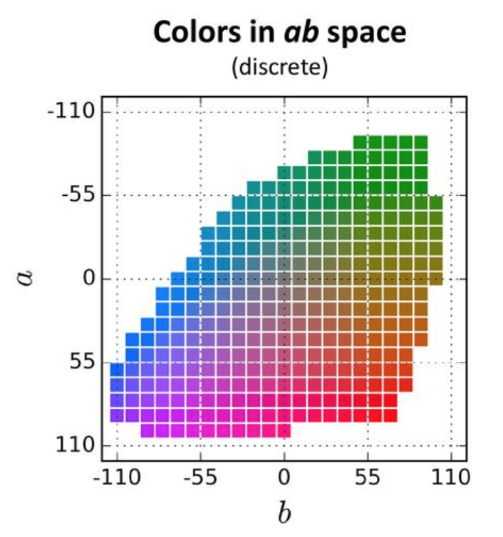
Stages Finished
Building and Model Training
“Colorful Image Colorization” Architecture:-
Inputs “L-Channel”
Preprocessing “Color Space Quantization”
Outputs “ 313-Vector for each Pixel ”

Slide 15
Stages Finished
Building and Model Training
“Colorful Image Colorization” Architecture Problems : -
Labels Size “ H * W * 313 * Samples ”
Pre / Post processing .
Accuracy.

Slide 16
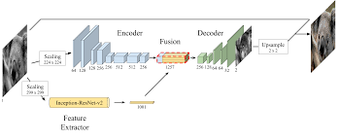
Stages Finished
Building and Model Training
We Second made an implementation of the “deep Kolorization” paper.

Slide 17
Stages Finished
Building and Model Training
“Deep Kolorization” Architecture:-
Inputs is “L-Channel” for encoder and inception model.
Preprocessing is “resizing and embeddings”.
Outputs is ‘ab’ channels.

Slide 18
Stages Finished
Building and Model Training
Why “Deep Kolorization” Architecture?!
Extracting powerful Features using Inception Resnet V2 pretrained model.
Labels are simply the ab channels of the image “H * W * 2 * Samples”.

Slide 19
Problems Faced
Limited Resources is one of the main problems we have faced .
Limited CPUs “RAM” and GPUs “No Nividia” , So we used Cloud Servers Like Google Colab and Kaggle .

Slide 20
Cloud Services
Cloud Service | Colab | Kaggle | Floydhub
CPU/GPU | Free GPU | Free GPU “Tesla K80” . | Tesla K80 GPUs.
Session (hours?) | 12 hours. | for 9 hours max. | -
VRAM | 12.70 GB . | 13GB. | 12GB.
Custom Packets | Uploaded Datasets. | Has lots of datasets. | introducing public projects and datasets.

Slide 21
Limitations
Training Limitations :-
Cloud Services support 13 GB RAM and 15 GB disk in case of GPU usage.
Color space used is CIE Lab color space not RGB.
Image size is 256*256 for Encoder and 299*299 for Inception model.

Slide 22
Experiments
Architecture | Cloud Server | Training Dataset | Optimizer | Batch Size | Learning Rate | Epochs | Testing Dataset | Accuracy
Colorful image Colorization | Colab | 1000 | SGD | 32 | 0.001 | 100 | 100 | 20.1928
Colorful image Colorization |  |  | Adam |  |  |  | 200 | 27.6854
Deep Kolorization |  | 1500 | RMSprop | 10 |  | 50 | 200 | 76.9989
Deep Kolorization | Kaggle | 3000 |  | 8 |  |  | 350 | 77.1020

Slide 23
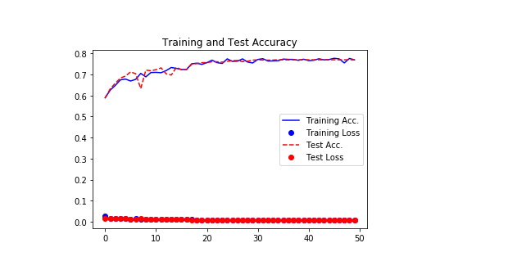
Experiments

Slide 24
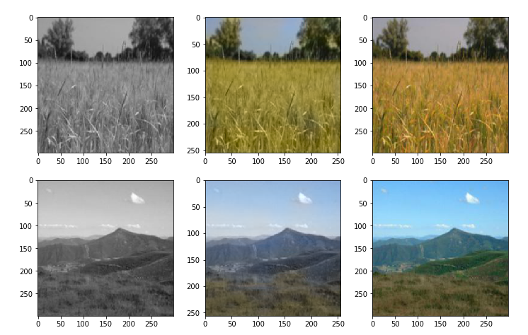
Results
Gray Ours Ground Truth

Slide 25
Next Step
Increasing Dataset samples and categories to get more accuracy.
Solving the RAM problem .

Slide 26
References
https://www.kaggle.com/
https://colab.research.google.com/notebooks/welcome.ipynb
Convolutional Neural Network based Image Colorization using OpenCV | Learn OpenCV
https://arxiv.org/abs/1712.03400

Slide 27

Any Questions?!

Slide 28
Thank You!

